Slide 1


Slide 2
Team Members
Tehreem Raghib 49005
Minahil Shareef 49004

Slide 3



“Desi Ventures is your go-to online platform for ordering and enjoying authentic Desi cuisine from the comfort of your home. With just a few clicks, customers can explore a diverse menu of traditional dishes, customize their orders, and have their favourite meals delivered right to their doorstep. ”
Notes:
NOTE: To replace a picture, just select and delete it. Then use the Insert Picture icon to replace it with one of your own!

Slide 4
Objectives
Increased Menu Visibility
Seamless Ordering Experience
User Account Management
Efficient Cart Management
Reliable Delivery Service
Feedback Collection

Slide 5
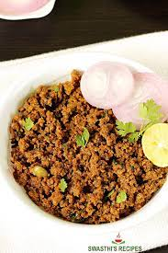
Modules
Search menu item.
Menu
Log in / Sign up
Cart management
Order details
Delivery
Contact us
Reviews

Slide 6
Conclusion:
Desi Venture is the key to unlocking the home chef's culinary potential. With objectives focused on visibility, efficiency, and support

